Slide 1
Employment Analysis
Based on Census Bureau Origin-Destination Employment Data
GIS
Notes:
Hey everyone, thanks for coming today. Before we get started, we need to do a little housekeeping. First, I’m no longer an employee of the city of kyle, as of about a month ago I now work as a GIS analyst for the Texas division of emergency management. But, I still know and have a good relationship with everyone at Kyle, and they were kind enough to let me continue with this presentation.
1 min

Slide 2
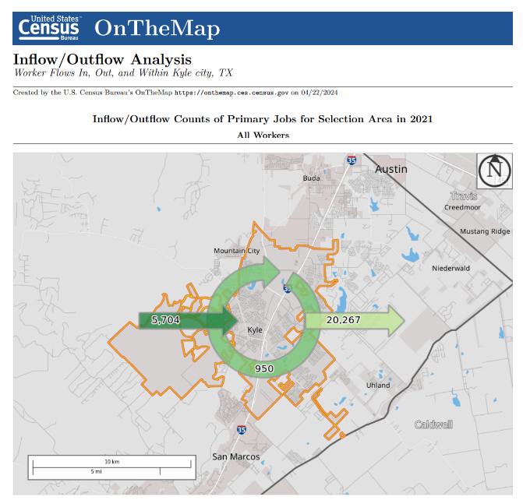
Introduction
A story about data
Your own data journey
Employment Analysis 2
Notes:
2 parts, first a story about data. Where it comes from, what you can do with it, how did this come about. 2nd is an overview of how you can use it in your own analysis.
30 seconds
1:30 total

Slide 3
Introduction
Appx 20,000 Residents Leave City for Work
Only 1000 Residents Work in City
45.5% to Austin
2x to San Marcos than stay in city
Employment Analysis 2
Notes:
As I said, this story is about data, and as most data stories do, this story stared with a question. Our ED came to us with questions about employment, and commutes and other things that to me sounded a little too targeted. I asked them where the question were coming from and this is what they showed me. They created this from a tool I’ll show you in just a second, and from this they wanted to know more. Why us? Why did they come to GIS? Other than because it exists on a map? Well, as a small city we don’t have a housing department with demographers to do this kind of work. We don’t even technically have a GIS department, we just have 2 people doing all GIS work from the planning department. And because we’ve always been the ones to handle “data”, the questions came to us. Sound familiar?
Now, what is this showing? Its showing the inflow and outflow of workers to and from the city of kyle. 20,000 people leave the city limits every day for work, compared to about a 1000 people that stay in the city and about 6000 that travel into the city for work.
2 min
330 total

Slide 4
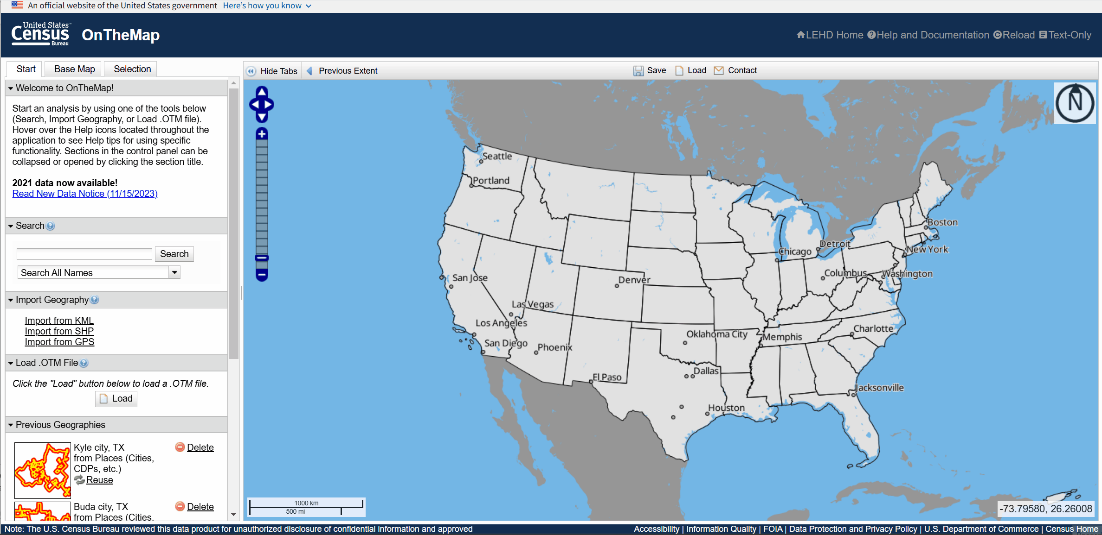
Introduction
Employment Analysis 2
Notes:
1 minute
430 total
This is how you use the census bureau tool.

Slide 5
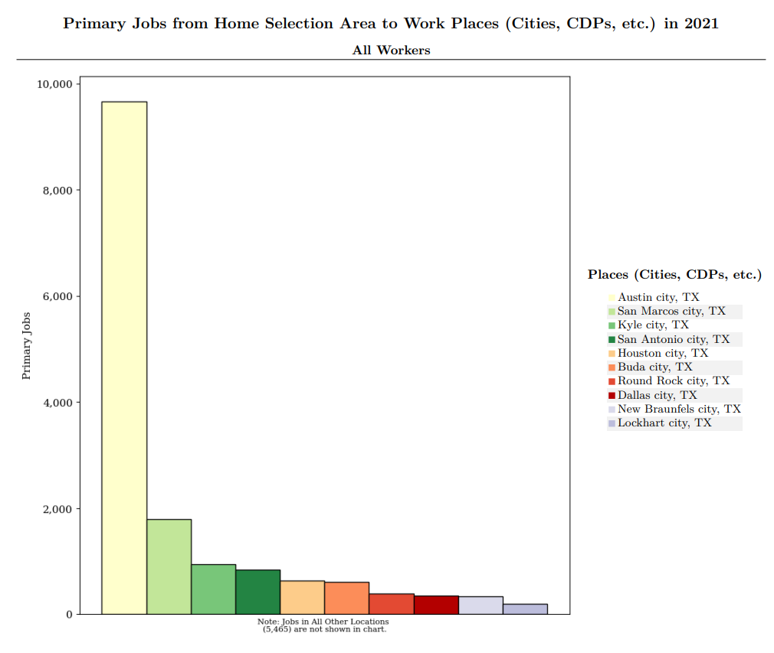
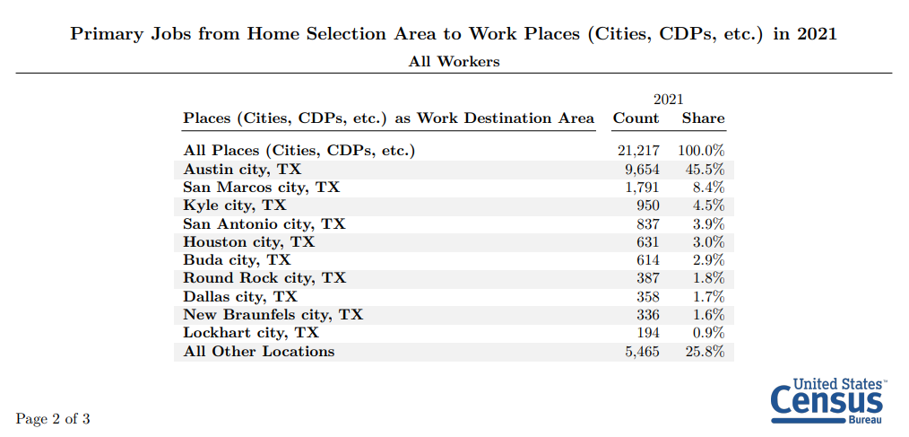
Introduction
Employment Analysis 3
Notes:
You can download a report with information like this. …
1 minute
530 total

Slide 6
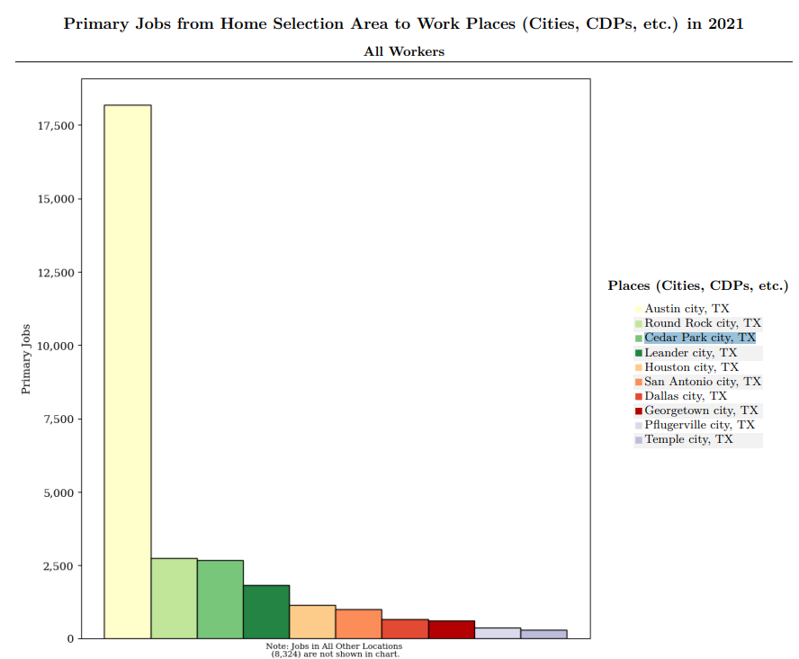
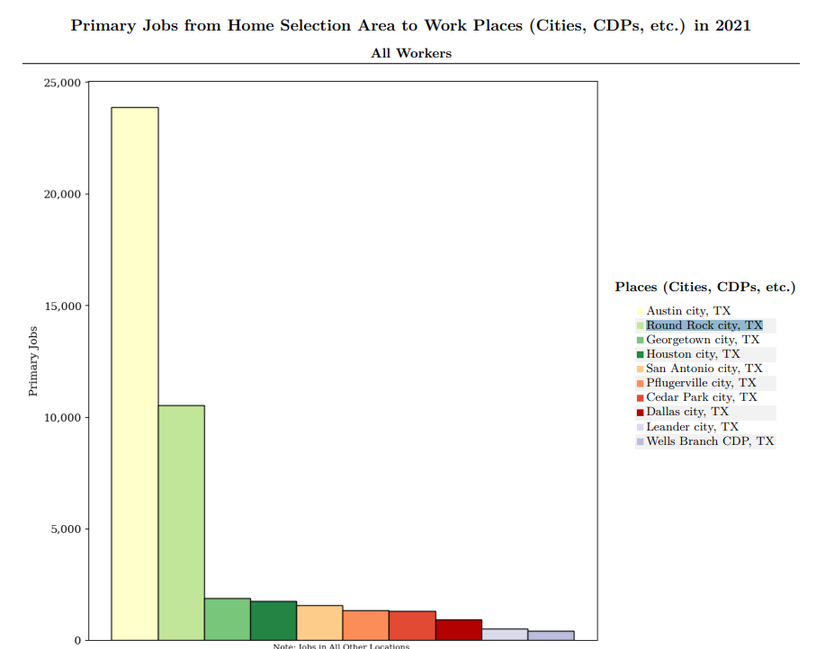
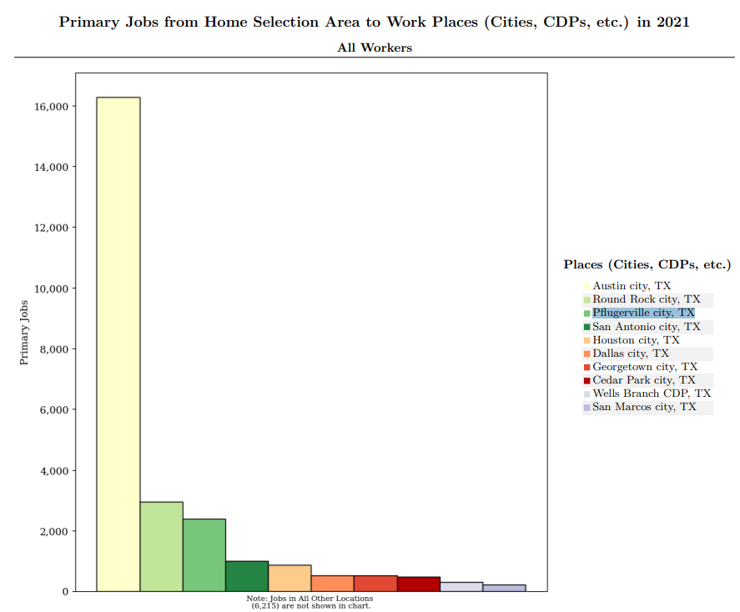
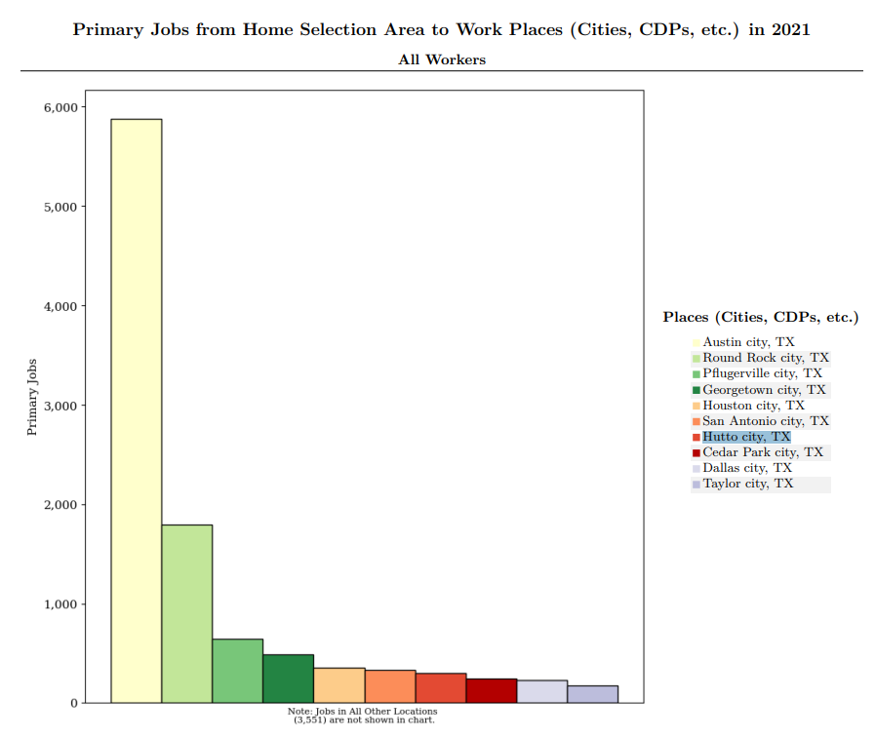
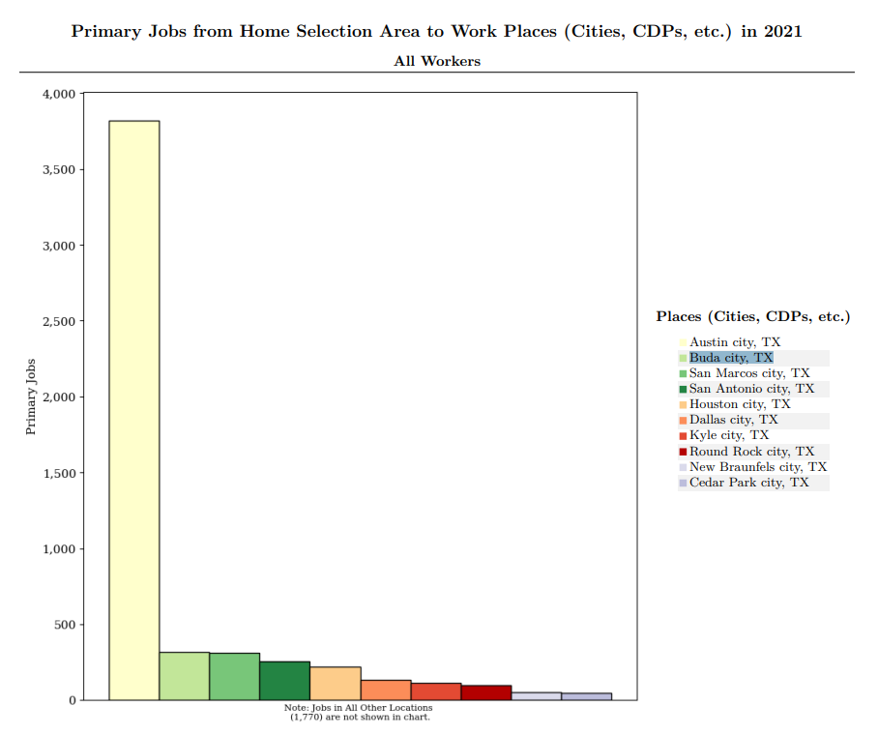
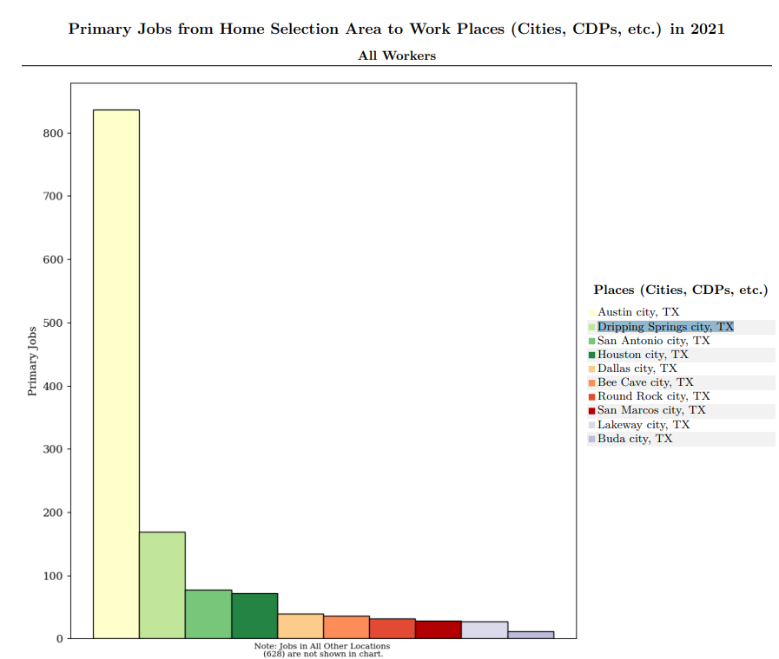
Cedar Park
Round Rock
Pflugerville
Hutto
Buda
Dripping Springs
Other Cities
Employment Analysis 7
Notes:
You can see how enticing this information is and how useful it could be, particularly to an economic development department that’s trying to bring targeted jobs to the city.
1 min
630

Slide 7
Data
Census topics
ACS topics
Community Pulse Survey etc.
Where does this data come from?
Can I have it?
What can I do with it?
Employment Analysis 2
Notes:
As a data analyst, as I started to look through the information provided by On The Map, one of the first things I thought of when I saw this was, where does this data come from? Its not from the census, not from the ACS, and not from smaller surveys like the CPS etc. I know the data that I can get from those, and none fo them include this fine detailed employment data. The second question I had was, can I have it? If I can have it, what can I do with it? And just to give you a little teaser about where we’re going before I get into the dry part of this presentation,
30 secs
7 total

Slide 8
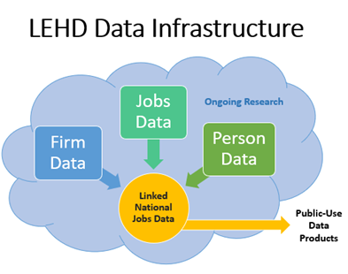
Data - The Longitudinal Employer-Household Dynamics program (LEHD)
Links employer and household data from state-supplied administrative records
Creates a longitudinal data system on U.S. employment.
State-of-the-art methods to protect the confidentiality of the original respondents
https://lehd.ces.census.gov/#about_us
Employment Analysis 4
Notes:
And so I started digging, and this is what I found. There is a department at the census bureau that does this kind of work. The longitudinal employer-household dynamics program. Their job is to gather employment information from state supplied sources to create a database linking jobs and households across the country.
1 min
8 total

Slide 9
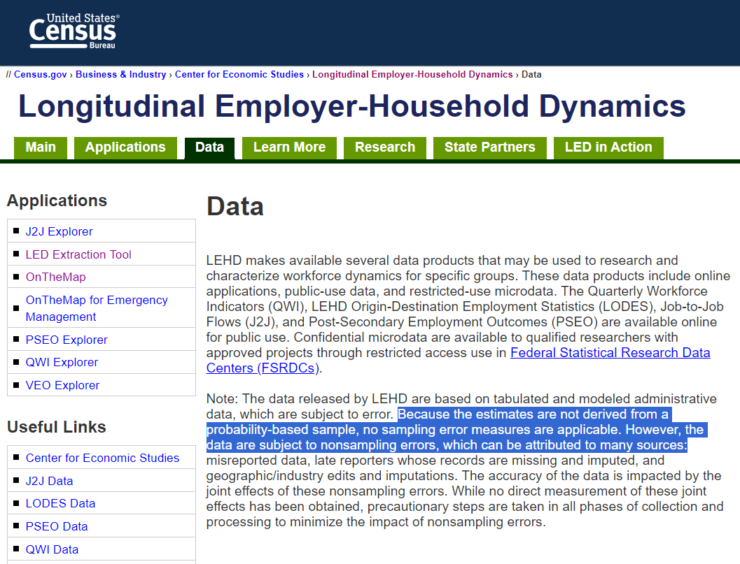
Data
Several Data Products: J2J, QWI, LODES, PSEO
Characterize Workforce Dynamics
Employment Analysis 4
https://lehd.ces.census.gov/data/
Notes:
And from that database they create 4 data products for public use. J2j, qwi, pseo, and lodes. These datasets characterize workforce dynamics. Now, its important to note that everything I’m going to show you from here forward all comes from just the LODES dataset.
1 min
9 total

Slide 10
Data – LEHD Origin-Destination Employment Statistics (LODES)
Not Survey Data
From 2021 (published Nov. 2023)
May reflect Pandemic Employment Patterns
Employment Analysis 4
Notes:
What is LODES? Lodes is a dataset of longitudinal origin-destination employment statistics. That’s a bit of a mouthful and here in just a second I’ll show you what that actually means, but first I want to point out a few things about the datset itself.
First, this is not survey data. You can read what it says, “”…. This is the census bureau using back channels to provide real, exact, data. And that’s what makes this so interesting and powerful.
Second, like the census itself, it takes a few years to build the datasets and publish them. As of now the data ranges from 1999 to 2021, and this 2021 dataset was released November 2023. So maybe next month we’ll get the 2022 datasets.
And third, because this is from 2021, some of the trends I’ll talk about may reflect pandemic employment patterns, i.e. lots of remote work.
2 min
11 total.

Slide 11
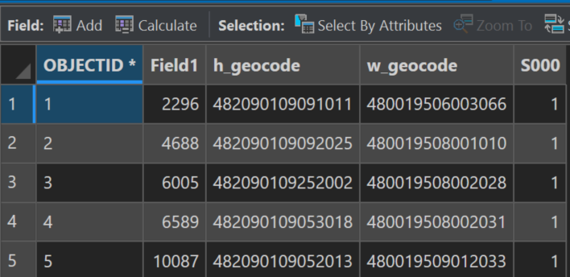
Data
Longitudinal Origin-Destination Employment Statistics
Where People Live
Number of
People
Origin-Destination Matrix
Based on Census Blocks
Downloaded by State
Where People Work
Employment Analysis 5
https://lehd.ces.census.gov/data/lodes/LODES8/LODESTechDoc8.1.pdf
Notes:
And finally, onto the data itself. In the second part of this presentation I’ll show you where and how to download it, but for now I just want to describe it.
The data exists as an origin-destination matrix representing every combination of home area and work area for employed people, by state. It is aggregated at the census block level, the smallest level of detail published by the census bureau, which again, makes this incredibly useful.
It works like this, for every row in the table you see the h_geocode field? Those numbers represent codes for census blocks and the h_geocode represents the home census block. The last number S000 represents the number of people that share this relationship. So if 10 people who lived in one census block, and all worked in the same second census block, S000 would be 10
This matrix is the basis for all of the calculations. And its really as simple as these 3 things, I know where people live, I know where they work, and I know how many have that spatial relationship.
You download the dataset by state, and when you open it, it has more than 10 million rows, which makes it a little difficult to work with.
First though, for a small prize, does anyone know the maximum number of rows excel can open in a spreadsheet? 1,048,576 rows according to google, which is 2^20, a 21 bit number of 1 followed by 20 zeros 100000000000000000000. Why 21 bits? No idea
4 mins
15 total

Slide 12
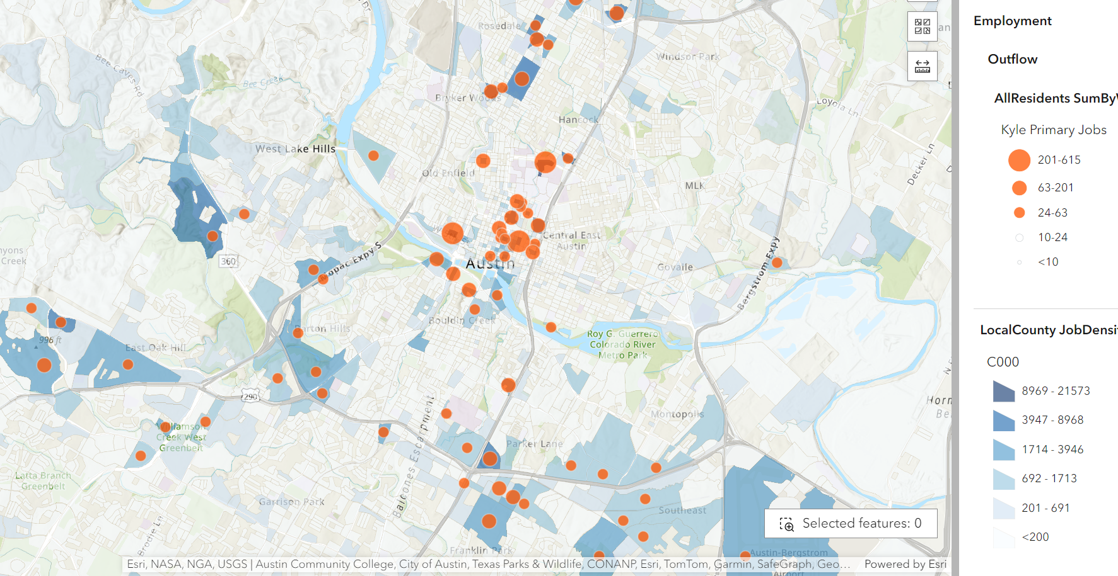
Outflow
Employment Analysis 9
Notes:
How do you represent that on a map? I decided to do it the same as the census bureau. I used a sum and group by to count how many Kyle residents worked in each non-Kyle census block. From there I displayed the blocks using graduated symbols categorized by natural breaks. That’s what you see here in orange, then number of people who live in the city of kyle and work in each of these census blocks.
And because I have the dataset for the whole state, I did a second sum and group by to count the total number of jobs in each census block, which is what you see in blue, the total jobs in each census block. This was just a very small preliminary analysis that I thought might help me see if Kyle residents were overrepresented in any particular census block, though I didn’t expect anything to come of it.
But you can start to see how valuable this information is. I have, on a map, data representing kyle employed residents vs total jobs. I could do a statistical analysis to look for significant trends. Again, this is spatial data, this opens up the whole world of spatial analysis. I could pull some other meaningful dataset, say city of austin zoning and perform an overlay analysis and see whether there are any zoning types that are particularly dense with jobs in total or kyle resident jobs. I could grab a street network dataset and do a number of different network analyses. I could look at the city of kyle and make informed guesses about where residents are driving every morning and get a sense of where we need to focus our road investments. All without paying for a single traffic study.
Or, I could put this all in a web map and let the people making the decisions, those in economic development or higher, make their own judments.
4 minutes
19 total

Slide 13
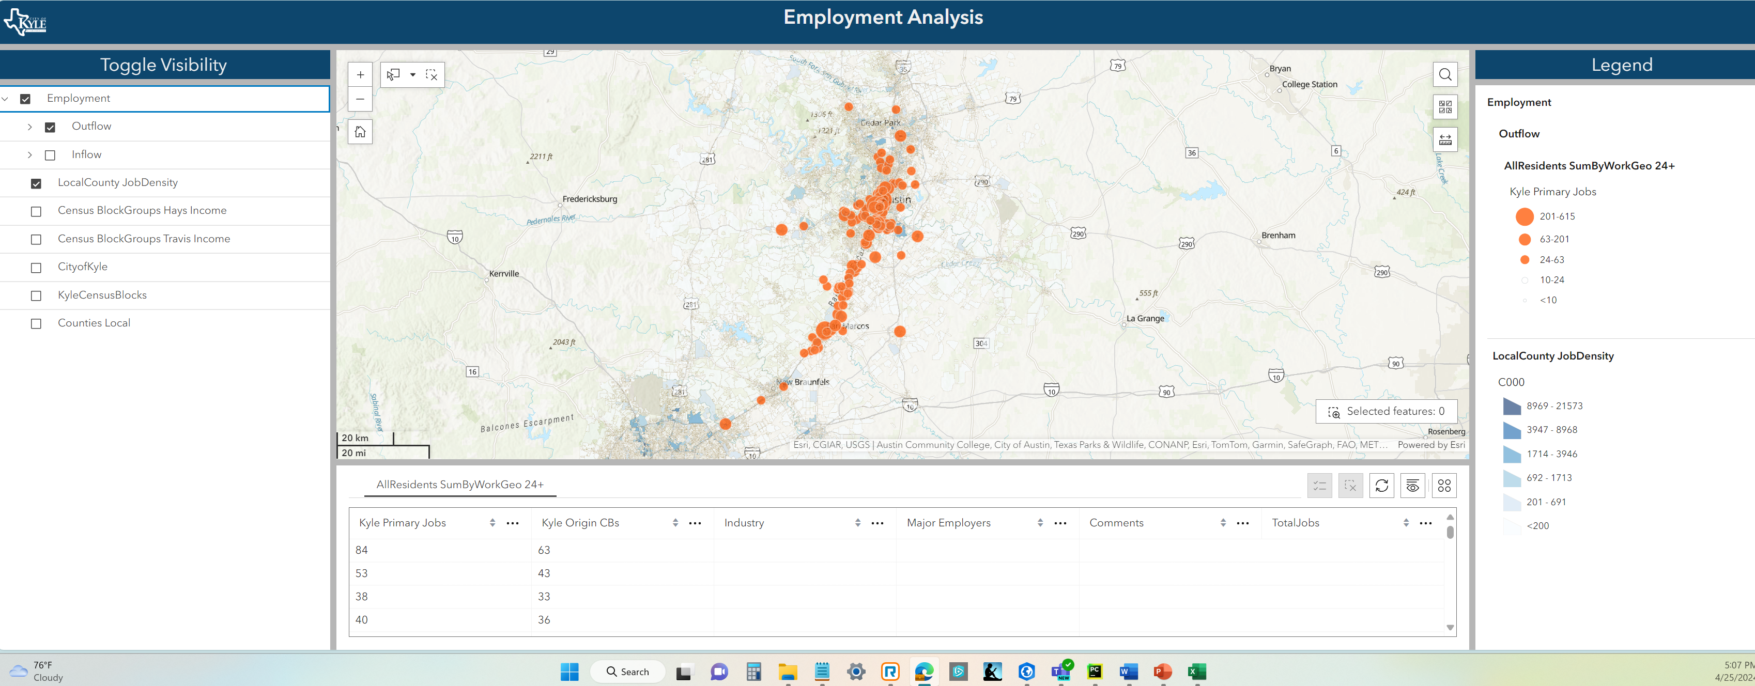
Data Explorer
https://experience.arcgis.com/experience/7cb3733b35b244908f09527dd7cf9658
Employment Analysis 15
Notes:
Which is what I did. And, if I happened to have 2 free days and a lot of coffee, I could go look at each of these census blocks with a lot of kyle residents working there and make a list of the biggest employers. That’s part of the beauty of this data being aggregated at the census block level. For most of these, the block level is a small enough space that I can easily see who the major employer is.
(pan and zoom around map to show major employers of kyle residents. Talk about things I see:
Federal office building, breck downtown, UT with only 1 census block populated, Texas state with the same thing also note that 10% of the university employees live in Kyle? Handy for ED to know. Look at midtown medical and show how even though not all of them are heavily populated, as an “industry” they make up a lot of the cities employes.

Slide 14
Outflow-Large Employers
Texas State University – 615
JJ Pickle Federal Bldg – 436
University of Texas – 327
Seton Central – 201
SMCISD – 140
Caldwell County – 124
Buda Warehouse District – 119
Austin Community College – 112
Employment Analysis 10
Notes:
1 minute
25 total

Slide 15
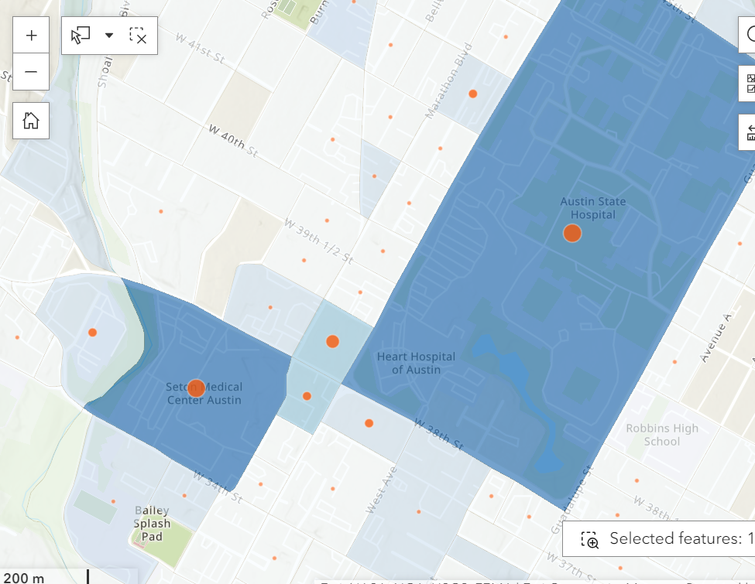
Outflow- Notable Private Sector
Midtown Medical District: 317
Seton Central Hospital - 201
Heart Hospital of Austin/State Hospital/Medical Office Space - 64
Seton Shoal Creek Hospital - 11
Midtown Medical Offices – 31
St. David’s Downtown: 59
University Medical Brackenridge: 100
Employment Analysis 11
Notes:
So while none of the individual hospitals make up as many employees as the universities or federal buildings, as an industry, medical services does rival some of the bigger census blocks.
1 minute
24 total

Slide 16
Outflow of Primary Jobs by Type
Census Blocks with More Than 30 Kyle-Resident Employees
Census Blocks with >30 Kyle-Resident Employees account for:
8275 of the 20k outflow employees
200 of the 7000 Census Block destinations
Likely accounts for majority of Federal, State, County, City, and Higher Education Jobs
JJ Pickle Federal Bldg, IRS, Rep Offices, Economic Dev Commission, Marshall Services
DPS, TDEM, GLO, Fire Protection, School for Deaf, HHS, Comptroller, TxDot Austin
Frost Bank Tower, Barton Creek Plaza Buildings, Barton Skyway Office Buildings, 816 Congress High Rise
NXP Semiconductors, DELL, AMD, Intel, Applied Materials, Apple Austin HQ
Caldwell County Offices, Travis County HHS, Travis Public Defenders office,
Cabela's, Target, Kohls, Walmart, HEB, restaurants, Southpark Meadows, San Marcos Premium Outlets, Harbor Freight, Pluckers, LA Fitness, Tanger Outlets San Marcos, Texas Old Town, Tractor Supply, Conn's, Frost Bank, Dollar Tree, McCoy Corporate, Fairfield Inn
Austin PARD, City of Buda, Austin PD, Austin Code Dept, Austin Muni Court, Austin Water, City of San Marcos, San Marcos PARD
University of Texas, Texas State University, Austin Community College, St. Edwards University
McGinnis Lockridge (610), Texas Disposal Systems, Chuck Nash Auto Group, Cap Metro, US Foods, Crestview RV, YETI, Gary Jobs Corps, Tito's Distillery and Distribution
Amazon, Cart.com, Wesco, Thermo Fisher Scientific, Genotex Labs, Asuragen Bio-Tech, Four Hands Home Store, Eden Equipment, USA Wire and Cable, Builders First Source, GeoSolutions Inc, Independence Brewing, Pepsi-Cola, Clinical Pathology Labs, Flex Advanced manufacturing, UPS
St Davids 30th St, Seton Central Austin, University Medical Brackenridge, State Hospital of Austin, Heart Hospital of Austin, St. Davids South Austin, Midtown Medical office building, Austin Advanced Pain Care
San Marcos ISD, Del Valle ISD, Dripping Springs ISD, Austin ISD Valor Austin, Westlake HS,
Employment Analysis 14
Notes:
And if you keep going, you can come up with something like this. Now remember, I made this for our economic development department. Listed in grey are the industries I didn’t think they could go after, so to speak. They’re not gonna get a federal or state office building, or a university. But what about the other sectors?
2 minutes
27 total

Slide 17
Inflow
Employment Analysis 2

Slide 18
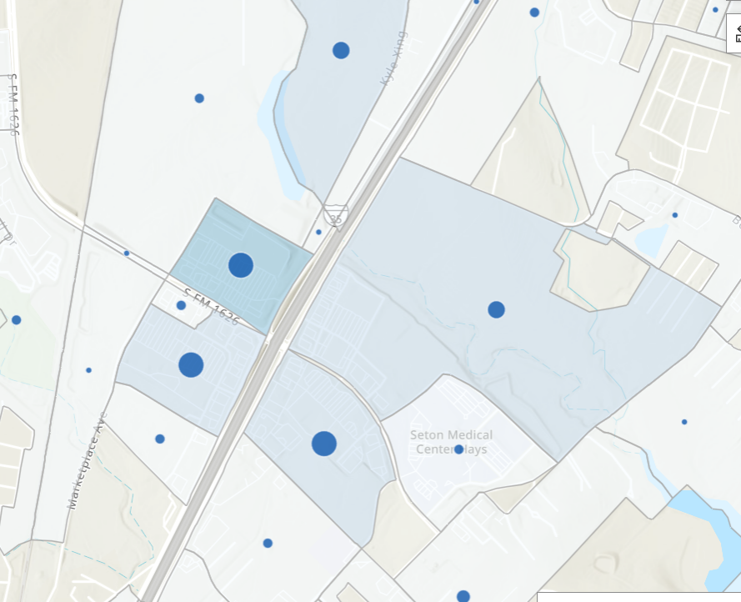
Inflow
Appx. 6000 People Travel to Kyle Census Blocks for work
Appx 2100 IH35/1626 districs (HEB, Target, Walmart, etc)
174 to City Hall Census Block
Most coming from San Marcos, Buda, South Austin
Employment Analysis 12
Notes:
Now, all of that was outflow, but what about the inflow? What about the 6000 people that live outside the city and drive to us every day for work? What can we learn about them? Well it turns out that the majority of those were employed in just 4 census blocks. An HEB strip center, a Target, Ross, and Kohls strip center, a Walmart strip center, and a fourth with a lot of retail and restaurants. That got me thinking. I now know where the people coming and going from our city are working, but I still don’t know why were losing 20000 people a day.
3 minutes
30 total

Slide 19
Inflow-Outflow Median HH Income
Incorporated Median Household Income from 2021 ACS 5-Year Estimates at Census Block Group Level*
Based on where workers live (Home Census Block)
Averaged by
20k Outflow
6k Inflow
950 Work and Live residents
*Travis and Hays Counties Only
Employment Analysis 13
Notes:
1 min 31 total
And so I started looking for more data. And again, the beauty of this data being aggregated at the census block level means that I can easily, without any interpolation or dealing with edge cases, attach the whole world of census data to my employment data. I started with a measure of income, I used the 5 year estimates from the American community survey to create a weighted estimate of household income of the three different groups of workers represented by this graphic. Because I know where these employed people live, I can estimate their income.

Slide 20
Inflow-Outflow Median HH Income
$48,172
$82,072
$81,993
Employment Analysis 14
Notes:
Because I know where these employed people live, I can estimate their income. The 1000 people that live and work in the city, live in places that suggests they have a median household income of about $82,000. The 20000 people that live in the city but work somewhere else? Also live in places that suggest they have jobs that support a median household income of about $82,000. And the 6000 people that travel into the city? Only $48,000. Now, I’m sure some of you saw this coming 20 minutes ago, and yes it is obvious. But now I have data to back it up. I can show the economic development department and others that make decisions, hard data to support what we already knew.
3 mins
34 total

Slide 21
Part 2
How to do it yourself
Employment Analysis 14
Notes:
30 seconds
3430 total, leaving 10 minutes for the “lab” portion

Slide 22
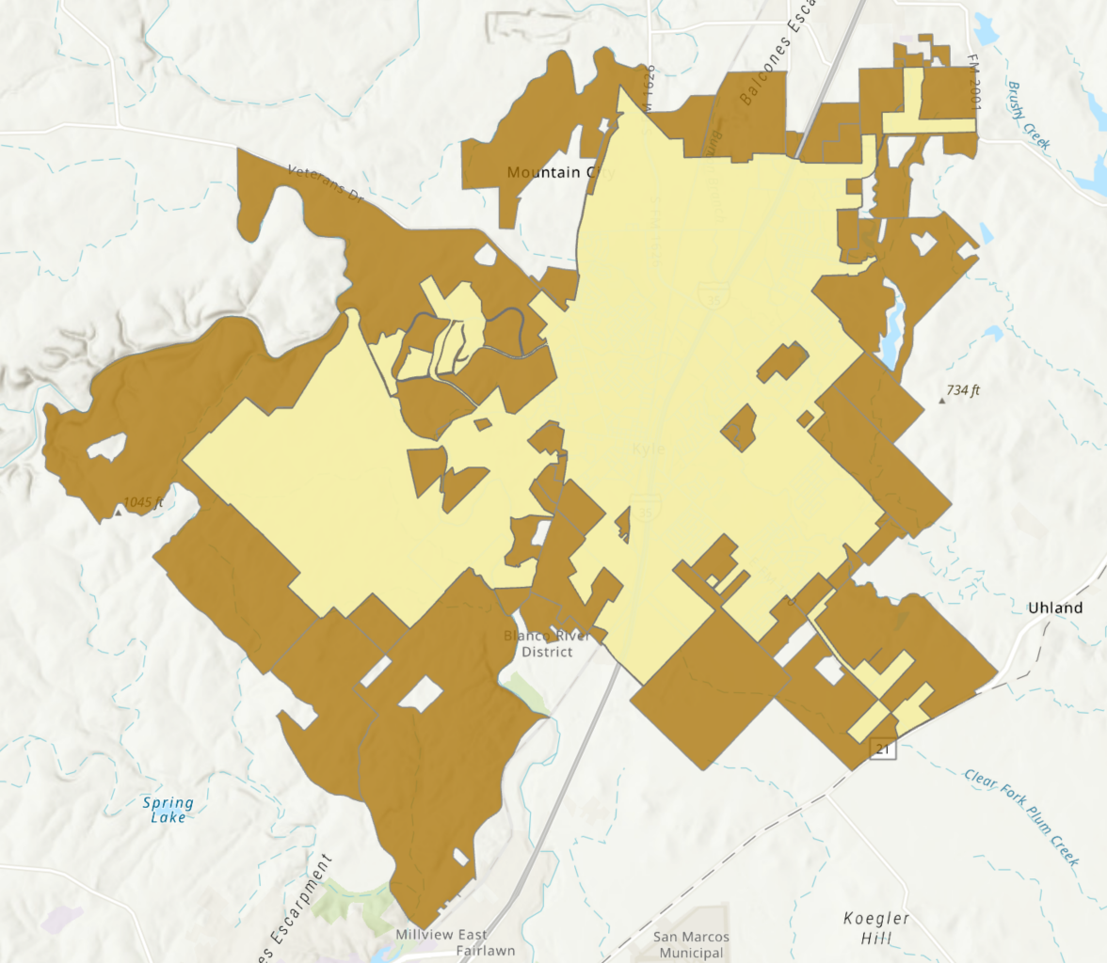
Discrepancies with On The Map
Census Bureau can aggregate based on exact city limits for On The Map
Only publish at census block level
Census Blocks don’t align with city limits
Employment Analysis 8

Slide 23
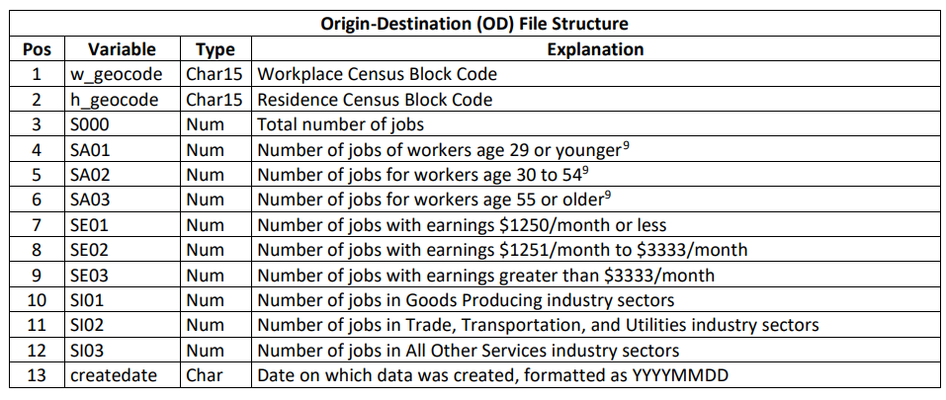
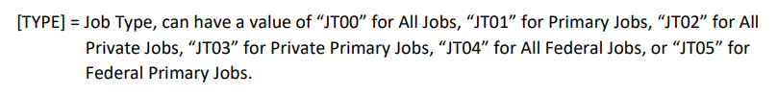
Data-Limited Analysis
Only Using Total Number of Jobs
Possible to split based on age or income
Possible to split by Job Sector
Employment Analysis 6
https://lehd.ces.census.gov/data/lodes/LODES8/LODESTechDoc8.1.pdf

Slide 24
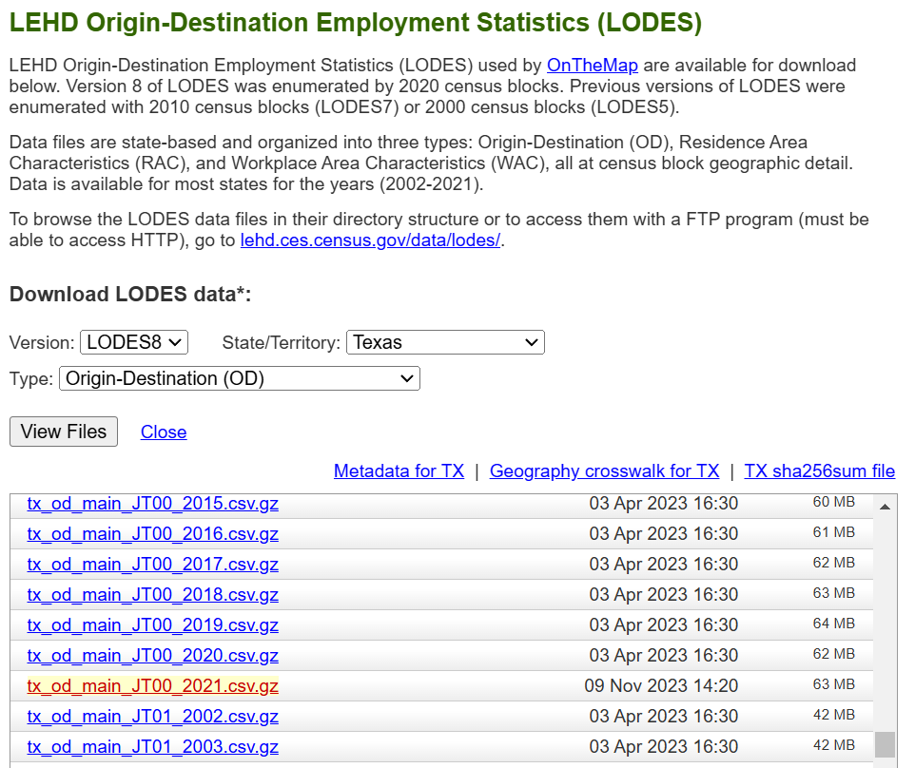
Download the Data
Scroll to LODES
Select the state and dataset
Be careful to download the correct file and year (JT00, main, year)
Employment Analysis 6
Data - Longitudinal Employer-Household Dynamics (census.gov)

Slide 25
Filter and Summarize
Where People Live
Number of
People
Origin-Destination Matrix
Based on Census Blocks
More than 10 Million rows in dataset, difficult to work with
Downloaded by State
Where People Work
Employment Analysis 5
https://lehd.ces.census.gov/data/lodes/LODES8/LODESTechDoc8.1.pdf
Notes:
Once you have the data, the first thing you need to do is filter the data based on your study area. For example, I’m only interested in people who live in the city of kyle, so I first filtered the data using h_geocode.

Slide 26
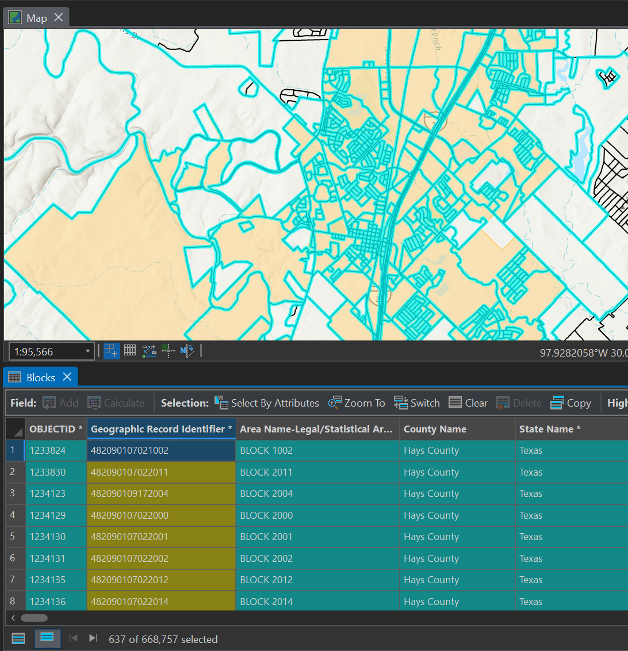
Filter and Summarize
Use Select by Location to get a list of census blocks in your study area
Employment Analysis 5
Notes:
Once you have the data, the first thing you need to do is filter the data based on your study area. For example, I’m only interested in people who live in the city of kyle, so I first filtered the data using h_geocode.

Slide 27
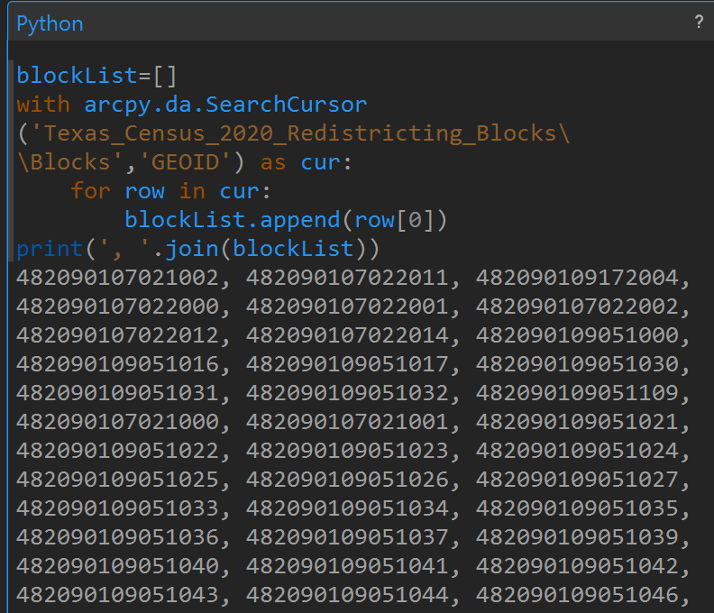
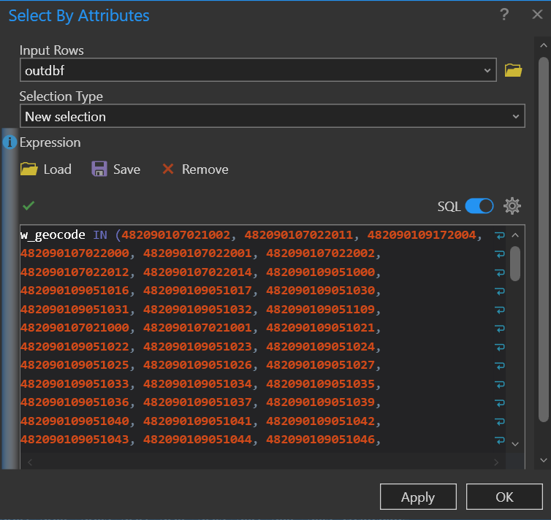
Filter and Summarize
Very simply Python to get a list of selected census block IDs
Use the list to build a query in Select By Attributes
Employment Analysis 5
Notes:
Once you have the data, the first thing you need to do is filter the data based on your study area. For example, I’m only interested in people who live in the city of kyle, so I first filtered the data using h_geocode.
blockList=[]
with arcpy.da.SearchCursor('Texas_Census_2020_Redistricting_Blocks\\Blocks','GEOID') as cur:
for row in cur:
blockList.append(row[0])
print(', '.join(blockList))

Slide 28
Filter and Summarize
Where People Live
Number of
People
Need one-to-one join
Case field is GEOID for Census Blocks
SUM_S000 is the total number of people.
Where People Work
Employment Analysis 5
https://lehd.ces.census.gov/data/lodes/LODES8/LODESTechDoc8.1.pdf
Notes:
Now, you want to be able to join that table with the census blocks, but to do that you need a one-to-one relationship. So first, you need to, speaking in SQL terms, Sum S000 and Group By h_geocode.

Slide 29
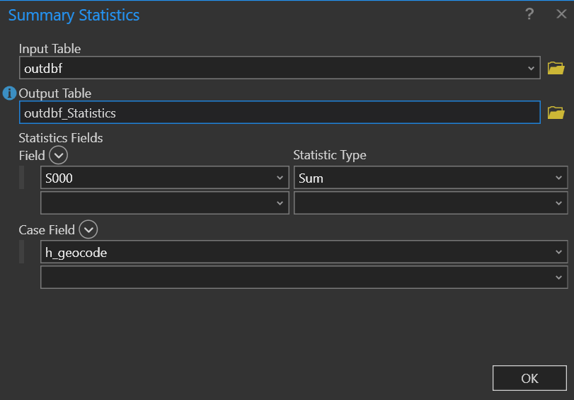
Filter and Summarize
w
Employment Analysis 5
Notes:
In ArcPro it looks like this. You use summary statistics to ‘sum’ on field S000, and use ‘w_geocode’ as the case field.

Slide 30
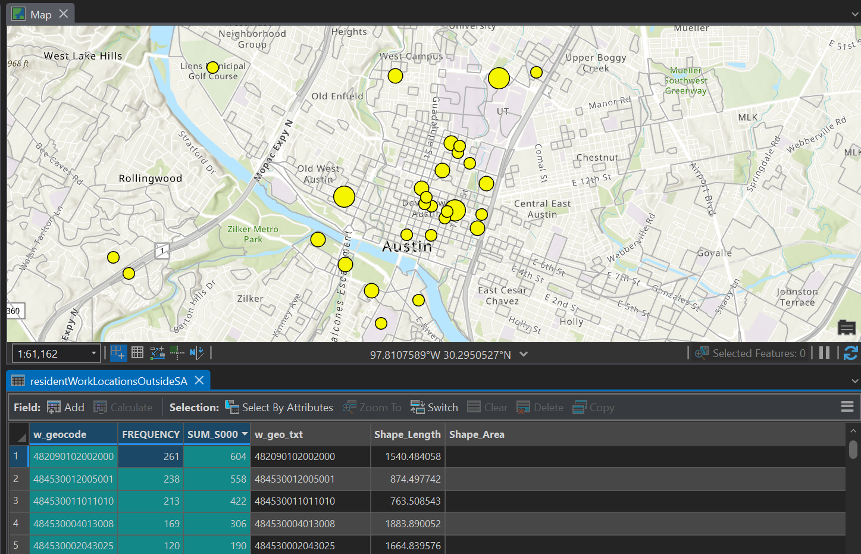
Join and Display
Employment Analysis 5
Notes:
And finally you can take that table, join it to the census blocks, and display it however you’d like. In the table it will look something like this. In one column, I have the work geocodes for ONLY city of kyle residents, because remember, I started by filtering all the data to only those rows where the w_geocode was inside the city of kyle. And in the SUM_S000 column you can see how many people work in each of the census blocks.

Slide 31
Data Explorer
https://experience.arcgis.com/experience/7cb3733b35b244908f09527dd7cf9658
Employment Analysis 15

Slide 32
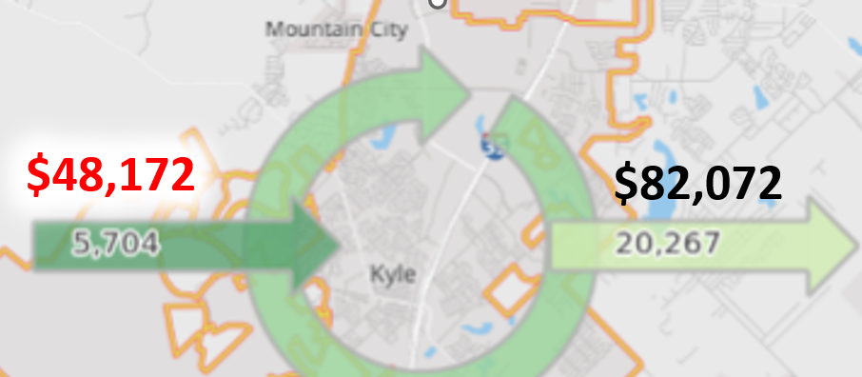
Summary
Employment Analysis 14

Slide 33
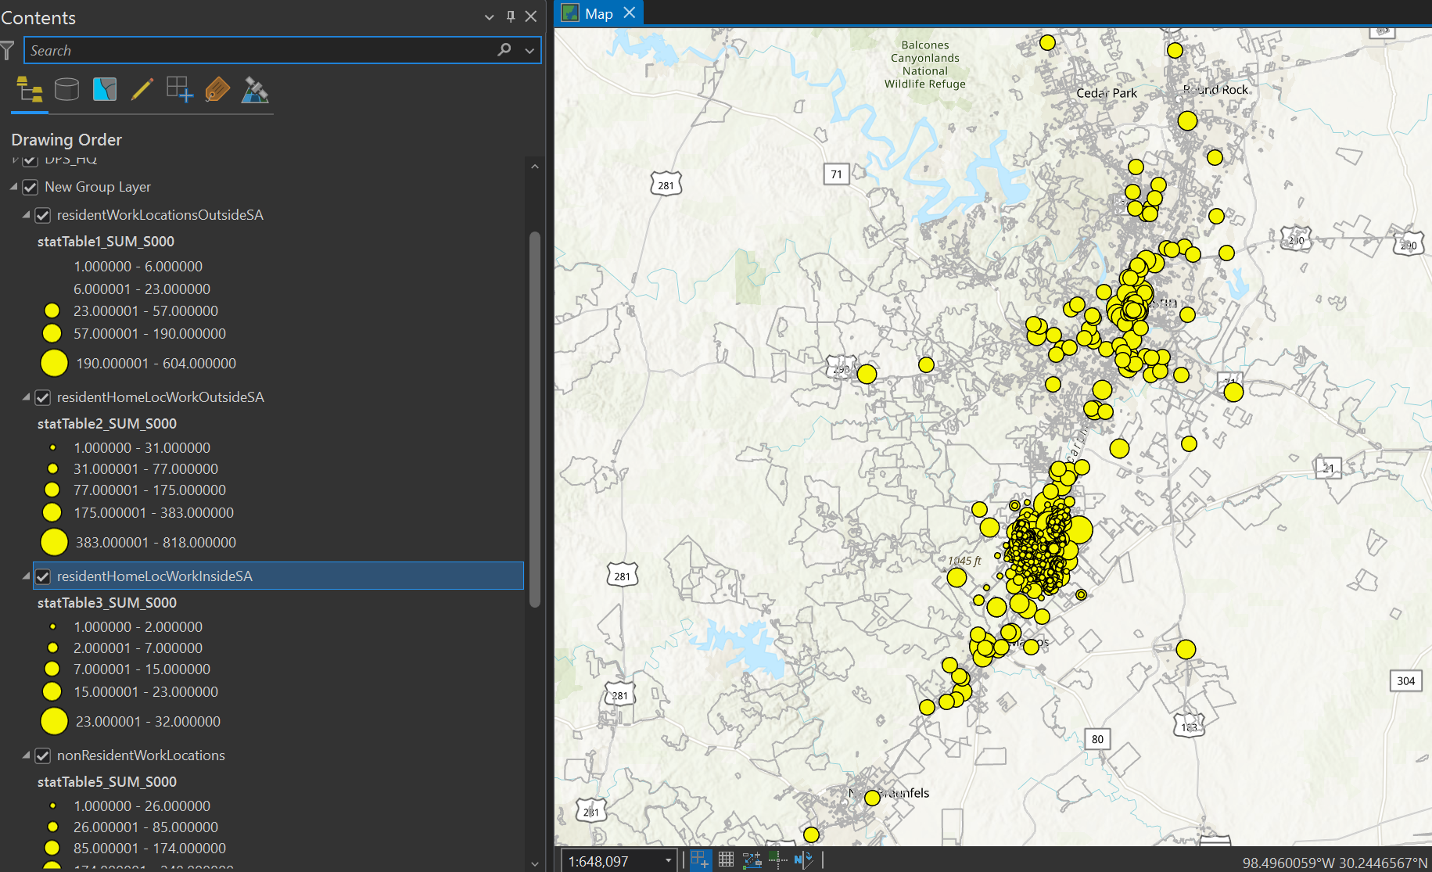
Script Tool
Employment Analysis 14

Slide 34
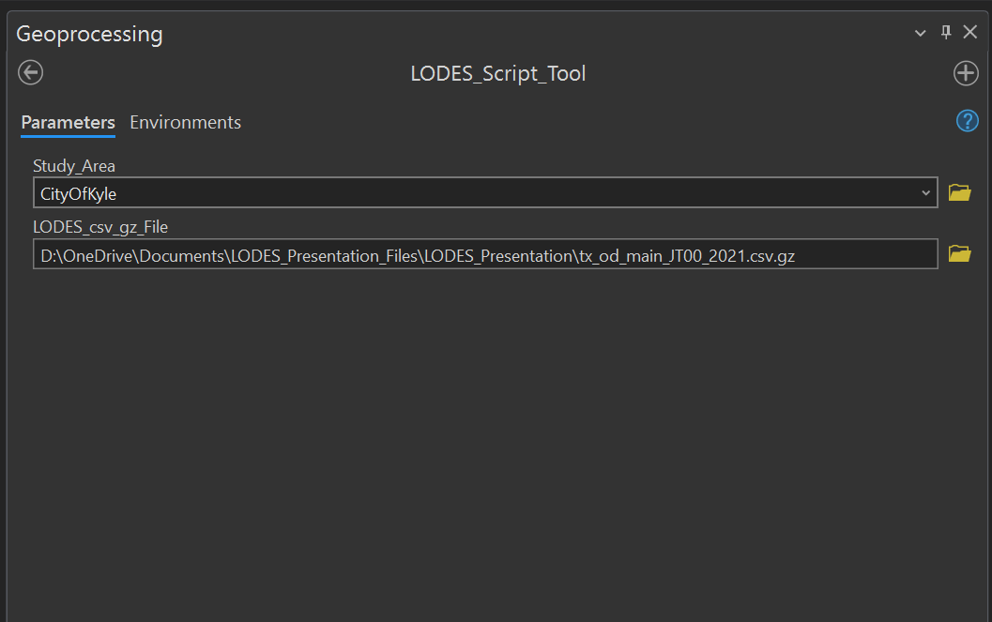
Script Tool
Employment Analysis 14

Slide 35


Questions?
Github Repository
Chad Ramos M.A.Geo.
Geospatial Systems Analyst
Texas Division of Emergency Management
Chad.g.ramos@gmail.com
Employment Analysis 15

